Slide 1
CS 455 Team 8
roAp Identification
Jacob Romeo, Aliya Trussell, David Serfaty

Slide 2
Overview

Slide 3
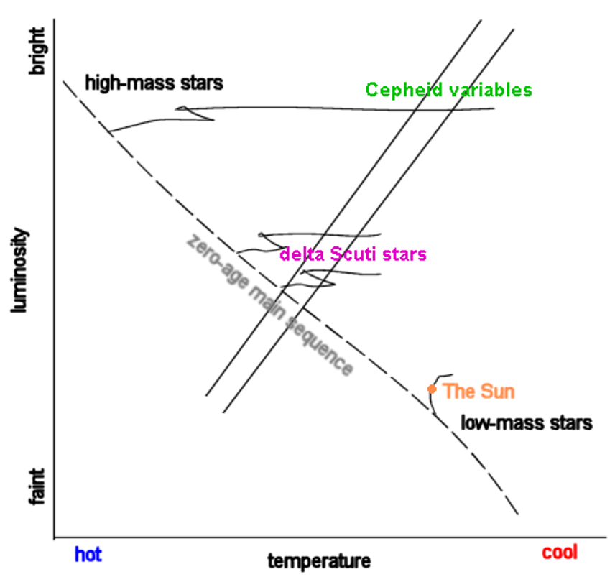
What is a RoAp?
Stands for Rapidly Oscillating Ap Star
A-F type stars of 1-2 solar masses
Located on the Delta-Scuti instability strip of Main Sequence
Are chemically peculiar with elements Sr, Eu, Cr, and Si in their atmospheres
EX: HD 134214 with spectral type Ap SrEu(Cr), magnitude 7.46 with period 5.6 minutes

Slide 4
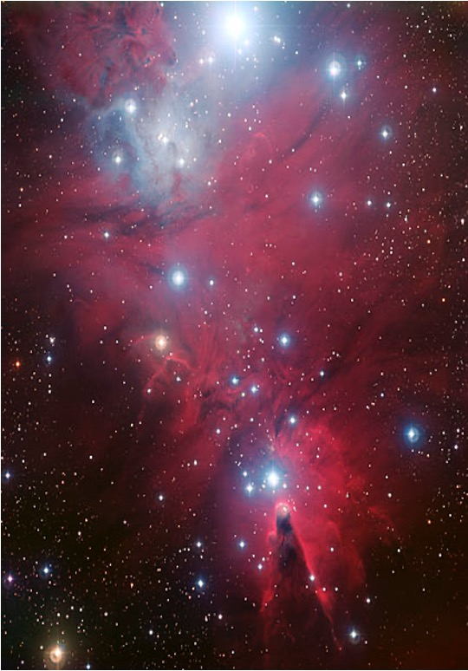
Project Goals
Using ML techniques to identify potential candidates for roAp’s based off dataset received from Gaia and starhorse databases.
Generating datasets of candidates for use in future research to find potential candidates inside clusters.
Cluster being used in the project is NGC 2264, seen to the left

Slide 5
Approach

Slide 6
Steps
First, we train a number of regression models on a pre-existing dataset of RoAp stars
Linear regression
Polynomial regression (n = 5)
The best degree for polynomial regression was also experimentally determined over testing several degrees
Elastic Net
Lasso
After running the regression models, we determine which stars are potential RoAp candidates based on given criteria
Finally, we save the identified candidate stars to a csv for use in future research & plot the results

Slide 7
Results

Slide 8
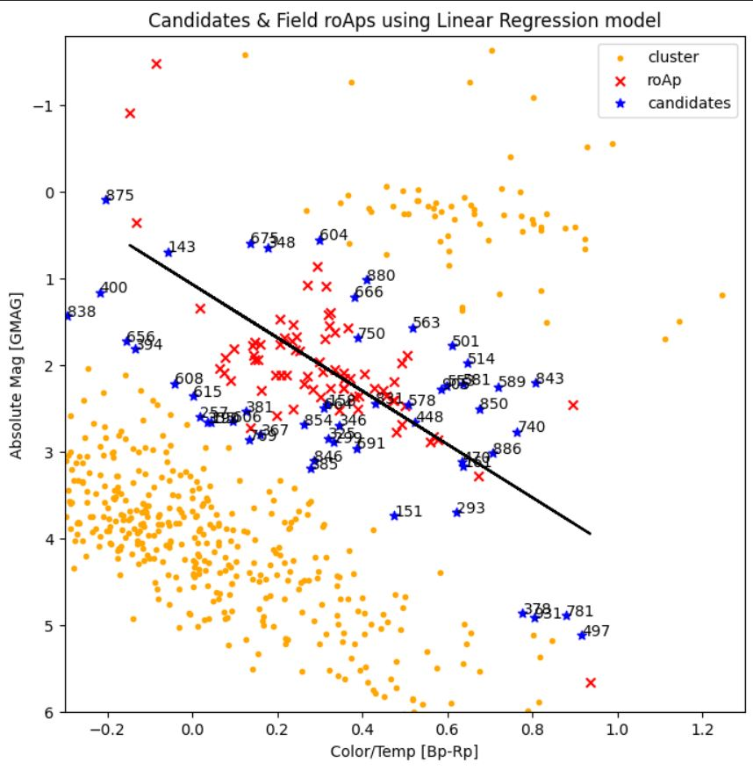
Linear Regression Results

Slide 9
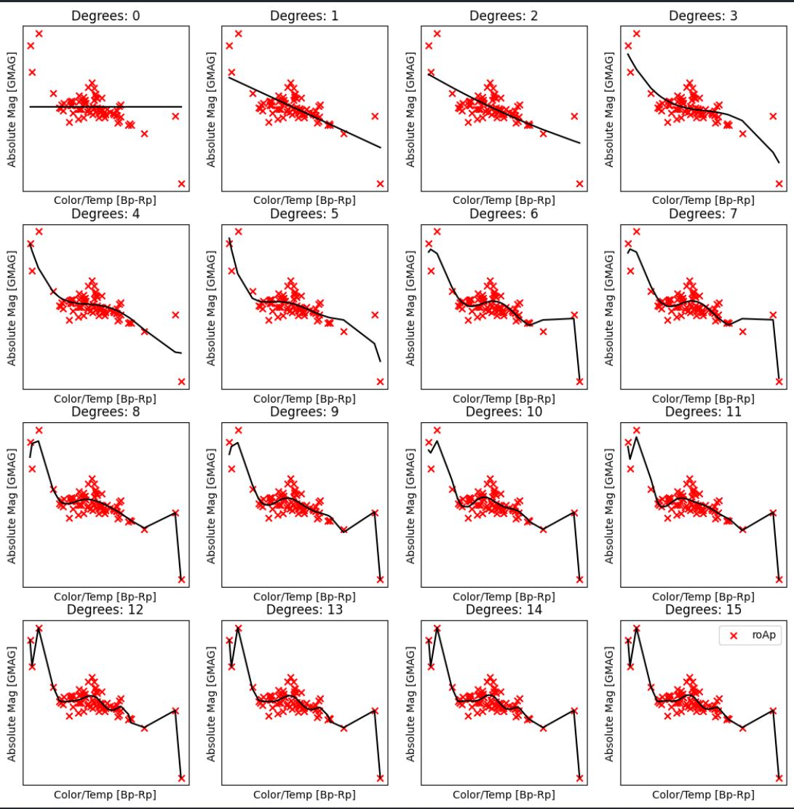
Testing the multiple polynomial degrees for the polynomial model to find the best results.
Deciding on n = 5 as the best polynomial model for no under/over fitting.

Slide 10
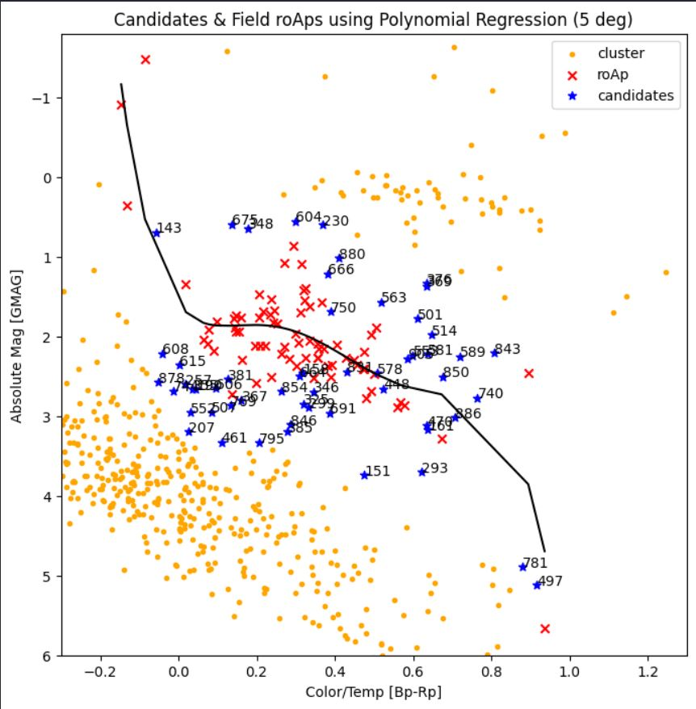
Polynomial Regression Results

Slide 11
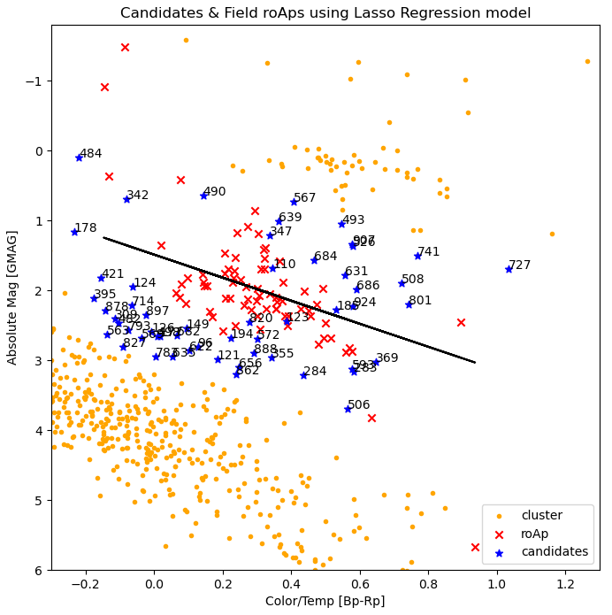
Lasso Results

Slide 12
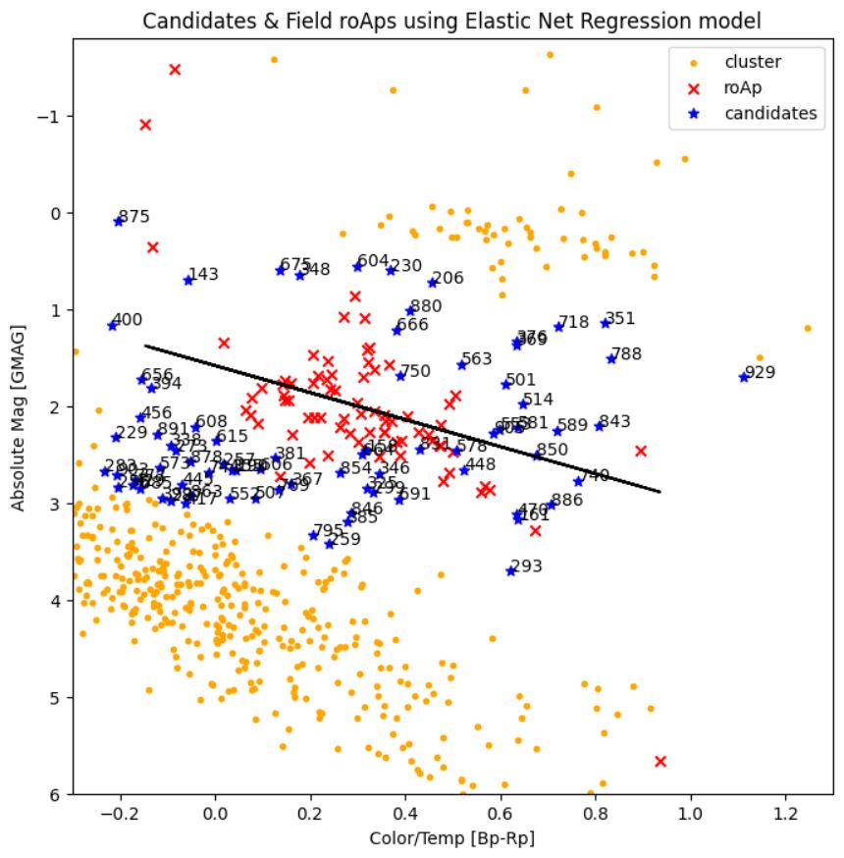
Elastic Net Results

Slide 13
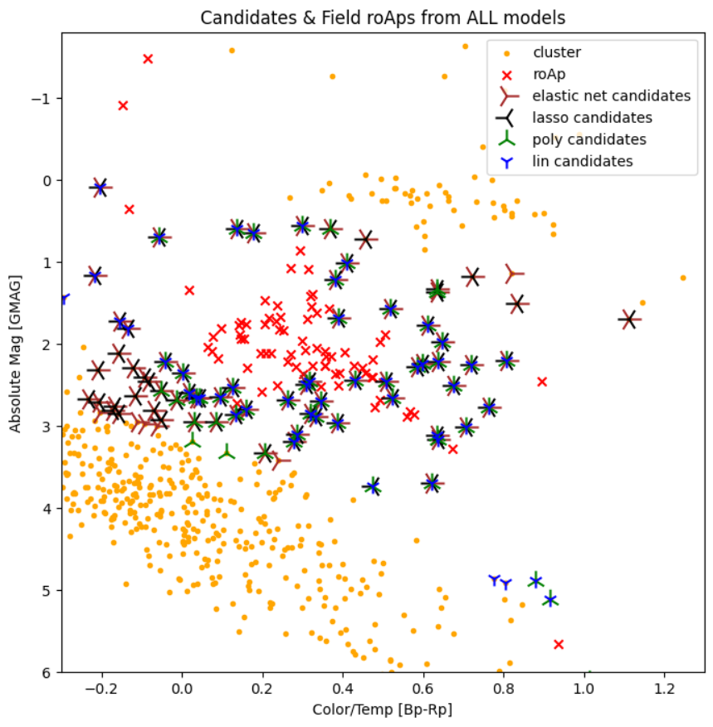
All identified candidates from each model, graphed together. Overlapping symbols indicate that the same star was identified as a candidate across different regression models.

